Slide 1
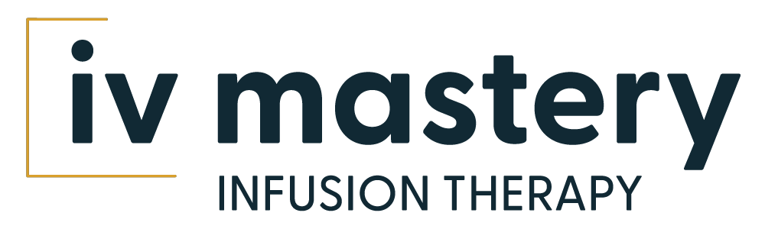
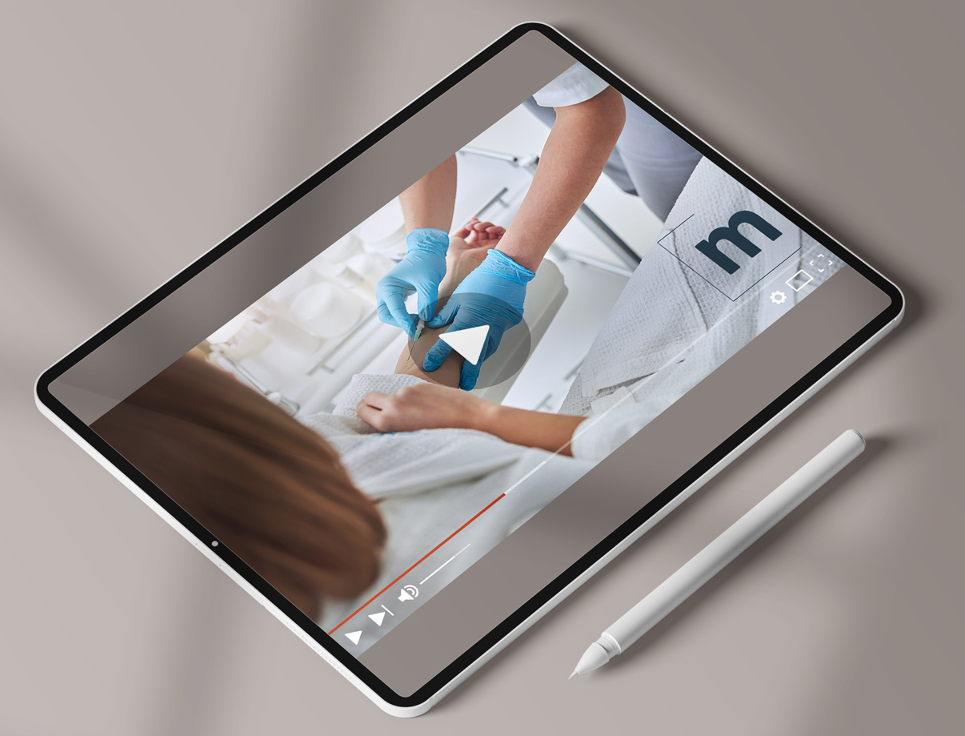
Infusion Therapy Online Training
STREAMLINING NURSING COMPLIANCE REQUIREMENTS AT SCALE WITH AI
INVESTOR PRESENTATION
Q3 2024
Privileged and Confidential

Slide 2

Expanding Reach in Infusion Therapy Education
IV Mastery is a subscription-based education platform with a 97% retention rate, partnering with large corporations and nationwide infusion companies.
Since its inception just three years ago, the IV Mastery platform has grown to 450+ facilities, 22 corporations, of which six are white-labeled LTC pharmacies, and over 20,000 users, from individual nurses to large health care corporations.

Slide 3
Market Opportunity
GLOBAL MARKET
TARGET MARKET
Intravenous (IV) Hydration Therapy¹
2023 | $3.04B 2028 | $4.49B
2023 to 2028 CAGR | 6.76%
27,000 | 16,000
Nursing Homes | Skilled Nursing Facilities
U.S. MARKET
6,000+ | 1,000+
Hospitals | Home Health Infusion Organizations
Online Learning Platforms²
2024 | $3.26B 2029 | $4.76B
2024 to 2029 CAGR | 7.86%
1M+ | 27M
Individual Nurses | Individual Nurses (Global)
22+
Countries Requiring Nurses to be IV-Certified
finance.yahoo.com/news/intravenous-iv-hydration-therapy-market-163100761.html
statista.com/outlook/emo/online-education/online-learning-platforms/united-states

Slide 4

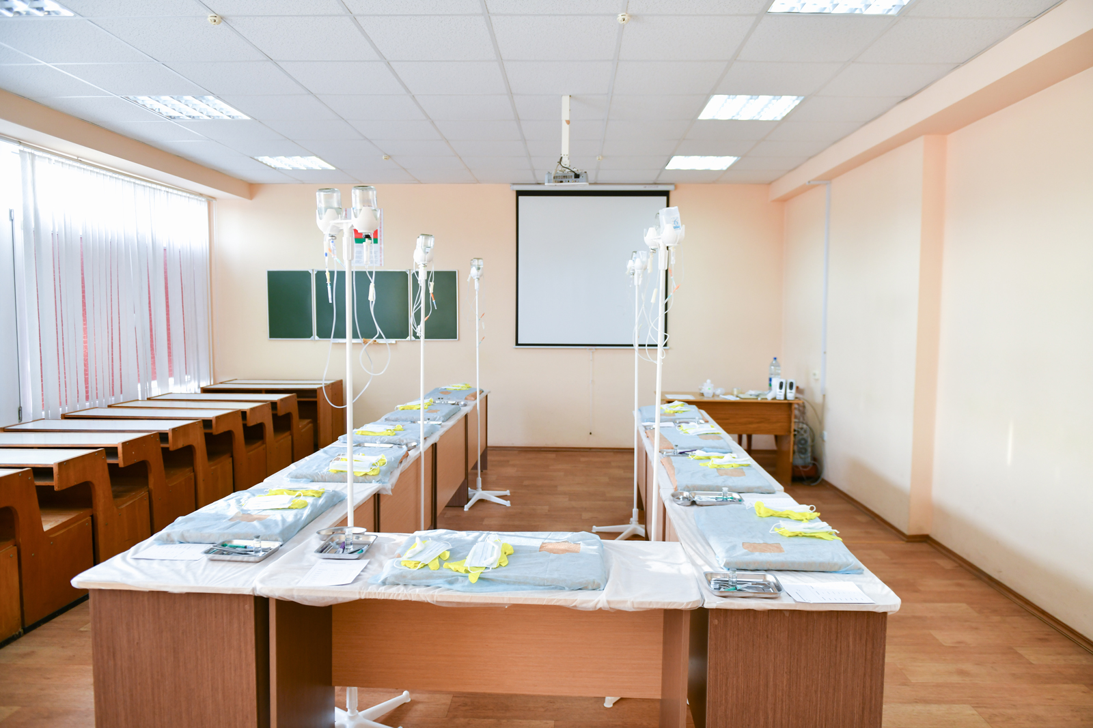




Problems with Traditional Classroom IV Training
Inefficient and non-iterative
Prioritizes direct instruction and scheduled sessions without the flexibility for real-time feedback or adjustments based on student understanding.
IV therapy education and competencies are a nationwide yearly mandatory requirement for nurses – but they are taught only in the traditional classroom method.
Non-standardized
Lack of standardization lead to inconsistencies in content delivery and educational quality.
Costly and time consuming
Challenges with scalability and flexibility, hindering personalized education and swift adaptation to new teaching methods and technologies. Financial penalties for deficiencies in IV training are severe.
Inflexible
Predetermined schedules and physical settings may not accommodate every student's individual needs or circumstances.

Slide 5


The IV Mastery Solution
Unique Offering
IV Mastery is the only provider combining online infusion therapy education with onsite clinical training. Other companies rely solely on onsite education and Zoom calls, which are logistically challenging due to current staffing shortages.
Benefits
IV Mastery provides a comprehensive learning experience accessible from anywhere, at a fraction of the cost of traditional onsite classes, making it a cost-effective and convenient solution for mandatory infusion therapy education.

Slide 6


Step-by-Step to Compliance Using AI
IV MASTERY PROCESS
Send welcome email to all nurses on behalf of facility administrator
Monitor progress toward course completion
Send quarterly report to facility administration
Register individual nurses
Assign courses
Monitor compliance
AI IN PLATFORM
TRAINEE + ADMINISTRATOR COMPLIANCE
Chatbot plus live support
LMS (learning management system)
Monitor compliance participation
Monitor activity (users, team leaders, and course usage)
Monitor yearly compliance for users and team leader
Receive education/training
"Train the trainer" (train the team leaders to conduct skills assessments)
Skills assessment (competency)

Slide 7
Business Model
Our clinical education is charged $100/hour
Facilities sign up from B2B, pharmacy referrals, and online requests
Single facility price $1500.00
Multiple facilities corporation $1000 per facility
Pharmacy referral $600-$900 per facility per year
Onsite clinical $100/hour
Onsite
Clinical
Practice Equipment
Subscription
Our practice equipment is sold at a price ranging from $150 to $350 with a profit margin of 75%
Equipment purchase
$150-$250 per practice equipment
Subscription average revenue per facility is $1000 per facility
Single users sign up directly online to get access to all our content
When they sign up, they have access to all our 20+ classes for all their nurses
Single user $200 per year

Slide 8

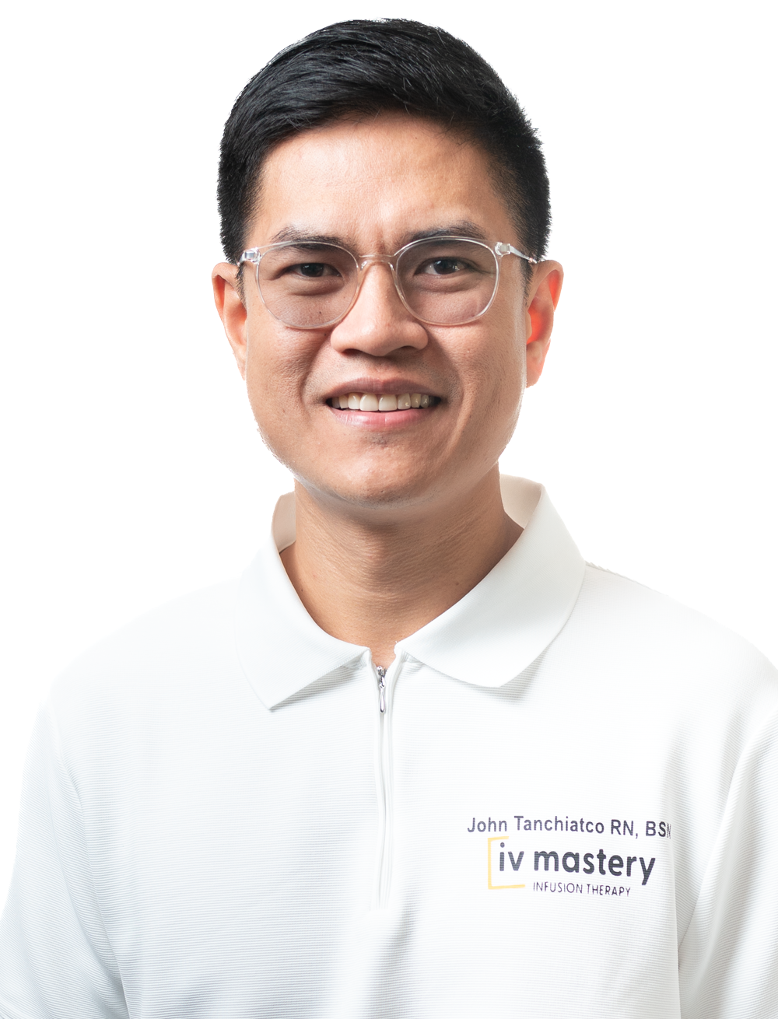

Leadership
Financial constraints should never influence the ability of healthcare workers to learn and expand their knowledge and skills.
Hugues Villeneuve RN
CEO AND FOUNDER
If you're offered a seat on a rocket ship, don't ask what seat! Just get on.
John Tanchiatco RN
COO
Hugues, a vascular access specialist with over 30 years of experience, founded IV Mastery, an online training platform, in response to the lack of effective training options.
Recognizing the need for better resources, Hugues developed an affordable and user-friendly solution to train healthcare workers in inserting peripheral lines, midlines, and PICCs using 3CG technology. Over the past six years, he has developed 20 courses offering more than 30 contact hours, significantly easing the education process for RNs, LPNs, and LVNs. IV Mastery aims to modernize education in skilled nursing facilities by making comprehensive IV training accessible anytime, thus setting new standards in intravenous practice. In Q3 2024, Hugues successfully exited PICC Performance, a vascular access company, so that he can dedicate his full focus to IV Mastery.
As a Registered Nurse with extensive teaching experience, John has led initiatives at IV Mastery to develop high-quality educational content for healthcare professionals, addressing the unique challenges in healthcare education.
His expertise in team management and operational efficiency enhances collaboration and drives business growth. John's strategic and analytical skills help optimize processes and improve user experiences. Drawn to IV Mastery’s global educational mission, he aims to advance healthcare education and make a significant impact worldwide. John believes his skills and experiences align well with the Chief Operating Officer role.

Slide 9

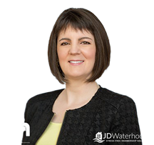


Team
Gabriel Villeneuve
HEAD PROJECT MANAGER
Julie Waterhouse
WEBMASTER
Since 2020, Gabriel has utilized his extensive healthcare experience at IV Mastery to develop new and effective course content.
His responsibilities include performing quality control, making necessary adjustments for implementation, and adhering to the industry's best practices, techniques, and standards to maintain high content quality.
Julie Waterhouse, a WordPress web developer and AccessAlly Certified Partner, brings over 30 years of experience in information technology.
Since 2020, she has been working with IV Mastery through her company, JD Waterhouse, developing their website, membership system, and automation solutions.
Antonio Pasquarella
ACCOUNTANT
Steven Becker
ATTORNEY
Antonio is a seasoned accounting professional with a robust background in various industries, including government, retail, technology, and real estate.
He graduated from Albertus Magnus College with a BS and an MBA in Business and Economics, concentrating in Accounting. Over the years, Antonio has provided his expertise to a diverse clientele, offering financial analysis, tax preparation, and business consulting services.
An accomplished Georgia business, contracts, and intellectual property attorney with over three decades of experience.
Now, as the owner of Becker Law LLC, Steve uses his comprehensive knowledge of the legal system and business world to help Metro Atlanta freelancers, startups, and small and medium businesses achieve their goals.

Slide 10





Target Market
Home Healthcare
Long-Term Care (LTC) Pharmacies
Skilled Nursing Facilities
Individual Nurses
Hospitals
IV Mastery offers expert-led, online training accessible year-round for a cost-effective monthly fee. It includes a white-labeling program for customization with company colors and logos, and a continuing education program designed to enhance retention and client satisfaction. Training is provided in 15 to 20-minute segments, making it suitable for healthcare workers to learn during downtime. The program is tailored to meet regulatory requirements and standards nationwide for skilled nursing facilities, ensuring staff remain compliant and competent. Nurses can achieve certifications in various IV procedures, including peripheral catheter insertion and parenteral nutrition management, through a platform that features modules with videos, quizzes, and additional learning resources.

Slide 11

Competitive Landscape
MAJOR PLAYER
IV Mastery competes in a dynamic market with players like Pedagogy Education, PICC Resource, and Infusion Knowledge.
COMPETITIVE ADVANTAGE
IV Mastery sets itself apart with its immersive and interactive training modules that simulate real-world scenarios, offering a flexible and practical learning experience that caters to the diverse schedules of busy healthcare providers.
NICHE MARKET
IV Mastery has carved out a niche for professionals seeking specialized IV therapy training and certification, ensuring they remain at the forefront of their field.

Slide 12






Current White Label Clients
Enhancing Long-Term Care Facilities Nationwide
PharmScript provides high-quality pharmacy services to long-term and post-acute care facilities, focusing on accuracy, timeliness, and efficiency, supported by advanced technology and continuous support services to enhance client service and patient care.
Pioneering Hydration Solutions for Nursing Homes
Dript combats dehydration in nursing homes through IV Hydration and Vitamin Nutrient Therapy, delivered by skilled nurses to improve clinical outcomes, enhance cognitive and functional health, and reduce hospitalizations.
Comprehensive Vascular Access Services Nationwide
Peak Mobile Vascular Access provides PICC lines, Midlines, and Peripheral IV services across America, emphasizing high-quality care, expert staff, and advanced technology to ensure successful patient outcomes and prioritizing tailored care and customer satisfaction nationwide.
Optimizing Medication Services Across Nine States
Partners Pharmacy services over 40,000 beds across nine states, utilizing their AP PassPort™ system to streamline medication access, reduce nursing workload, and enhance compliance, while collaborating with healthcare facilities to boost outcomes and cut costs.
Commitment to Community Health
Avera Health strives to enhance the health and wellness of people in South Dakota, Minnesota, Iowa, Nebraska, and North Dakota by delivering compassionate, values-driven care across both clinical and non-clinical settings.
Northeastern U.S. Pharmacy Services
Woodmark Pharmacy provides customized pharmacy programs using advanced technologies and detailed reporting to support informed decision-making, supported by its clinical, customer service, and pharmaceutical teams throughout the northeastern U.S.

Slide 13
Traction and Roadmap
Inception
$163,000 sales through networking
Rebranding, more content, customer experience improvement, and marketing
Expanded service portfolio with 17 classes, onsite clinical, and competency validation
150 facilities in 14 states
3 white-label sites
Launch with first facility and corporation
2017
2020
2021
2022
2023
Q1 – 2024
Signed first white-label pharmacy
$125,000 sales with over 50% profit margin
75 facilities using platform in 6 states
$216,000 sales
Practice equipment store launch
250 facilities in 33 states
$125,000 in sales through 120 new facilities and 3 white-labeled platforms
UPCOMING
Q2 to Q4 2024
In our pipeline
500 new facilities
$600,000 revenue with above 50% profit margin
"Meg" – our proprietary AI compliance monitoring
VR and ExR (Virtual Reality and Extended Reality)
BEYOND IV > MANDATORY COMPLIANCE MODULES
State survey compliance
Infection control
Wound care
2027
20,000 organizations
50,000 single users
$46M revenue

Slide 14
Financial Model
 | 2025 | 2026 | 2027 | 2028 | 2029
Sales
Subscription Revenue | 812,358 | 1,189,444 | 2,332,482 | 4,958,032 | 12,257,328
Clinical Education Revenue | 217,217 | 345,690 | 804,038 | 1,717,787 | 4,278,532
Equipment Sales Revenue | 36,797 | 54,082 | 103,774 | 229,148 | 591,761
Total Sales | $ 1,066,372 | $ 1,589,216 | $ 3,240,295 | $ 6,904,967 | $ 17,127,621
Cost of Goods Sold
Inventory | 6,359 | 9,168 | 17,257 | 37,379 | 94,691
Labor and Other Direct Expenses | 108,609 | 169,553 | 386,850 | 810,743 | 1,980,872
Other Direct Expenses | 13,615 | 28,685 | 38,213 | 59,089 | 116,025
Total Cost of Goods Sold | $ 128,582 | $ 207,406 | $ 442,320 | $ 907,211 | $ 2,191,589
Gross Margin | $ 937,790 | $ 1,381,810 | $ 2,797,975 | $ 5,997,756 | $ 14,936,032
Percent | 88% | 87% | 86% | 87% | 87%
Operating Expenses
Sales and Marketing | 125,000 | 197,130 | 407,481 | 1,015,847 | 2,604,062
General and Administrative | 170,637 | 238,232 | 413,145 | 806,326 | 1,883,839
Development & Maintenance | 438,710 | 196,689 | 330,862 | 626,185 | 1,446,211
Executive Salaries | 391,000 | 410,550 | 431,078 | 452,631 | 475,263
Sales and Marketing Salaries | 172,614 | 195,418 | 332,454 | 586,364 | 1,117,741
Product Development | 115,000 | 192,625 | 216,631 | 302,901 | 516,073
Customer Support | 138,000 | 144,900 | 152,145 | 217,441 | 379,744
Equipment Sales | 38,333 | 59,417 | 62,388 | 109,883 | 230,199
Depreciation and Amortization |  | 22,500 | 43,750 | 60,000 | 60,000
Total Operating Expenses | $ 1,589,294 | $ 1,657,461 | $ 2,389,934 | $ 4,177,578 | $ 8,713,132
Pre-Tax Income | $ (651,505) | $ (275,650) | $ 408,041 | $ 1,820,179 | $ 6,222,900
Income Tax |  |  | 81,608 | 364,036 | 1,244,580
Net Income | $ (651,505) | $ (275,650) | $ 326,433 | $ 1,456,143 | $ 4,978,320
EBITDA | $ (651,505) | $ (253,150) | $ 451,791 | $ 1,880,179 | $ 6,282,900

Slide 15
Use of Funds
ALTERNATE
OPERATIONS
SALES AND MARKETING
PRODUCT AND PLATFORM
28% | Executive Salaries
12% | General and Administrative
10% | Customer Support
12% | Sales and Marketing Salaries
9% | Sales and Marketing
2% | Equipment Sales
19% | Development and Maintenance
8% | Product Development
50%
23%
27%

Slide 16





Hugues Villeneuve
CEO AND FOUNDER
(413) 204-8631
hugh@ivmastery.com
https://ivmastery.com/
linkedin.com/in/huguesvilleneuve/
IV Mastery
72 Greenbriar Rd
Meriden, CT 06450

